Slide 1
Security Features on i.MX RT1050
MAY, 2017

Slide 2
OVERVIEW
Notes:
This section provides an overview of i.mxRT1050 security components, simply explaining the purpose of each of them.

Slide 3
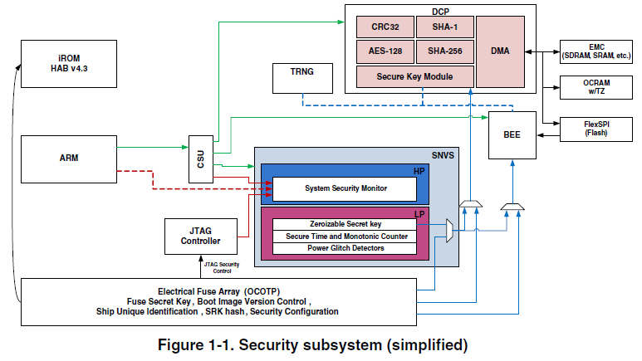
Security Subsystem
Notes:
Security execution units:
HAB – High Assurance Boot
BEE – Bus Encryption Engine
DCP – Data Co-Processor
TRNG – True Random Number Generator
CSU – Central Secure Unit
Security protection unit:
SNVS – Secure Non-Volatile Storage
Security configuration unit:
OCOTP – On-Chip One Time Programmable
Security debugging unit:
SJC – System JTAG Controller

Slide 4
Security Features
OTP (One-Time Programmable) memory
Provides on-chip electrical fuse arrays for storing important information
OCOTP (On-Chip OTP Controller)
Provides the primary user-visible mechanism for interfacing with the on-chip fuses
HAB (High Assurance Boot)
Provides a high-assurance boot feature in the system boot ROM, detects and prevents the execution of unauthorized software during the boot sequence
BEE (Bus Encryption Engine)
Provides an on-the-fly decryption engine, which is used for decrypting ciphertext of FlexSPI

Slide 5
Security Features (continued)
DCP (Data Co-Processor)
provides hardware acceleration for the cryptographic algorithms
TRNG (True Random Number Generator)
generates a 512-bit entropy as needed by an entropy consuming module or by other post processing functions
CSU (Central Secure Unit)
Sets access control policies between the bus masters and bus slaves, enabling the peripherals to be separated into distinct security domains
Notes:
Configurable permissions and access control
Certain keys no software can read can be used to encrypt data that binds it uniquely to the chip

Slide 6
Security Features (continued)
SNVS (Secure Non-volatile Storage)
Provides a non-volatile real-time clock maintained by a coin-cell battery during system power down for using in both the secure and non-secure platforms
Protects the real-time clock against rollback attacks in time-sensitive protocols such as DRM and PKI
Deters replay attacks in time-independent protocols such as certification or firmware revocation
Controls the access to the OTP master secret key used by the DCP to protect confidential data in the off-chip storage
Provides non-volatile highly protected storage for an alternative master secret key
Notes:
Configurable permissions and access control
Certain keys no software can read can be used to encrypt data that binds it uniquely to the chip

Slide 7
HAB
Notes:
High Assurance Boot
is a component of the Boot ROM
protects against the potential threat of attackers modifying the areas of code or data in the programmable memory to make it behave in an incorrect manner
prevents the attempts to gain access to features which must not be available
use RSA digital signatures to enforce these policies

Slide 8
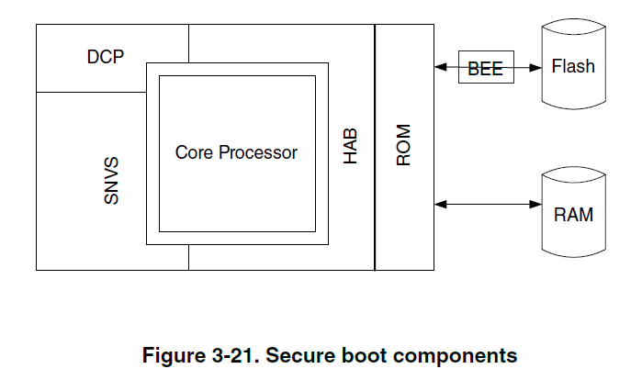
Block Diagram
Notes:
The HAB
interfaces with the SNVS to make sure that the system security state is as expected
uses the hardware block to accelerate the SHA-256 message digest operations performed during the signature verfication
includes a software implementation of SHA-256 for cases where a hardware accelerator can’t be used
supports 1024,2048 and 3072 – keysize
includes a software implementation of RSA signature verification operations in the HAB library

Slide 9
Secure Boot: HAB4 Features
Feature | HAB4 | Comments
Image authentication | Yes | Yes
Super Root Key | Multiple, revocable | Fused Hash
Public key type | RSA-4096 (max) | 256-bit security achieved with RSA-4096
Certificate format | X.509v3 | Tools support
CMS (PKCS#1) | CMS (PKCS#1) | Tools support
Hash algorithm | SHA-256 | NIST recommended
Image Encryption | Yes | Yes (HAB4.1 and later)
Wrapped key format | CAAM blob | Secret keys stored in secure RAM partition
Secret key type | AES-128/192/256
Decryption algorithm | AES-CCM | Authenticated decryption
Device configuration commands | Write value Set/clear bitmask Wait on bitmask | Provides flexible device configuration
Unlock commands | Field Return fuse Revocation fuses Secure JTAG CAAM/SNVS | Secure by default

Slide 10
Image Authentication
An asymmetric encryption is adopted to implement the HAB feature
The private key is used to generate a unique identifier for the image which is called a signature
The public key is attached to the image and used to decrypt the signature
A comparison is performed to check that the signature and the image match

Slide 11
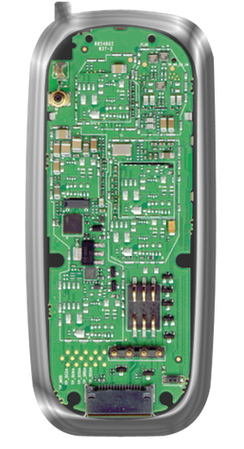

Boot ROM: High Assurance Boot
Code Signing
Using Private Key
Authentication
Using Public Key
Secured Environment
Run Image
SW Image
Compare
Reload Image
X
Hash
Reference
Hash
Generated
Hash
Public
Key
Verify
Hash
OTP
SRK
Sign
Private
Key
Flash
Signature
SW Image
SW Image +
Signature
SW Image +
Signature

Slide 12




NXP Reference Code Signing Tool
HAB Data
CSF Description File
+
Product Software
+
Performs the signature operations of both a
Certificate Authority and Signing authority
CSF Commands
Signed Product Software

Slide 13
Encrypted Boot
Extension of secure boot
Protection mechanism
Digital signature authenticates the source of the binary image
Encrypted image bestows confidentiality to the image data
Sign
Encrypt
Generate DEK blob and Assemble encrypted image
3-Step Process

Slide 14
Boot ROM: High Assurance Boot – Encrypted
Encryption
Using Secret Key
Decryption
Using Secret Key
Build
Environment
SW Image
Decrypted
SW Image
Device
Boot
Secret
Key
Decrypt
(AES)
OTP
Key
Secret
Key
OTP
Key
Encrypt
(AES)
Decrypt
(AES)
CAAM
(AES)
Manufacturing
Key Blob
Key Blob
Encrypted
SW Image
Flash
Encrypted
SW Image

Slide 15
Encrypting the Image
Freescale Reference
Code Signing Tool Host
HAB Data
CSF Description File
+
Product Software
+
CSF Commands
Data Encryption Key
Resulting DEK encrypted with a given public key provided in certificate form
Encrypted Product Software
Notes:
The DEK (Data Encryption Key) as well as the process of encrypting the image itself is done off-line. However this is not enough. A DEK blob must be created on chip (see next slide).
CST Tools run on a standard PC – either Linux or Windows
Acts as both:
a Certificate Authority (CA) – to issue HAB code signing certificates: SRK, CSF and IMG key certs, and
http://en.wikipedia.org/wiki/Certificate_authority
a Signature Authority (SA) – to perform the task of actually generating digital signatures
CST (Command Sequence File) accepts as input:
a product software image
a Command Sequence File (CSF)
and generates HAB data which is then merged with the product software image creating a final “signed” image.
The CSF description file defines:
The commands that HAB library in ROM will perform during SoC boot
The keys that the image is to be signed with
The memory regions that the signature or signatures will cover.
The HAB data contains:
CSF commands that are interpreted by the HAB library in the i.MX ROM
Digital signatures covering the image
Digital certificates holding the public key the HAB library in ROM uses to verify the image signatures.
Current status: As of Nov 2012 the CST support for encrypted boot is complete.

Slide 16
Provisioning DEK blob for Encrypted Boot
Data Encryption key
Download provisioning
i.MX
image+
Data
Encryption Key
ARM core
DEK
Data
Encryption
Key Blob
provisioned
to boot
device
CAAM Secure
Memory
Resulting Data
Encryption key blob
CAAM
One
-
Time
Programmable
Master Key
(Unique per IC)
OCOTP
Close configuration enabled

Slide 17
Encrypted Boot (Memory Layout)
Offset
0x0000
HAB Data (CSF)
0x0400
Entry
Image Vector Table (IVT)
DCD
Destination
Image Size
Boot Data
Boot Data
Signed Data
Plugin Flag
Device Config. Data
(DCD)
Note: HAB requires that:
the entire IVT
the entire DCD
initial byte of Boot Data
initial word of U-Boot must be signed or encrypted
U-Boot
Encrypted Data
0x2F000
HAB Data
(CSF, Certs, Signatures)
Fill Data
CSF Authenticate Data command
provides HAB with location of the
blob – must match location where the blob is provisioned
DEK Blob
0x31000

Slide 18
BEE
Notes:
Bus Encryption Engine
implemented as an on-the-fly decryption engine

Slide 19
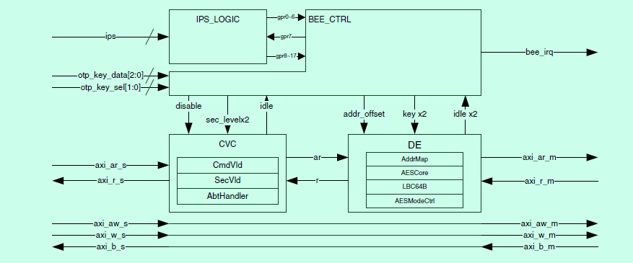
BEE uArchitecture
Four main functional sub-blocks: BEE_CTRL, CVC, DE, and IPS_LOGIC

Slide 20
Features
Standard AXI interconnection
On-the-fly AES-128 decryption, supporting ECB and CTR mode
Aliased memory space support. Address remapping for up to two individual regions
Independent AES Key management for those two individual regions
Bus access pattern optimization with the aid of local store and forward buffer
Non-secured access filtering based on security label of the access
Illegal access check and filtering.

Slide 21
BEE_CTRL
Synchronizing external hardwire inputs to BEE's internal domain
Work mode and internal workflow control
Internal interrupt handling

Slide 22
Command Validity Checker
Command validation (CmdVld)
Security level validation (SecVld)
Abort handler (AbtHandler)
Notes:
CmdVid:As BEE only supports 16 byte aligned and full size accesses, the Masters which issue AXI commands to BEE must make sure that all AXI commands do not violate the rule. If an unexpected command is sent to the BEE, CmdVld block will detect the violation and notify AbtHandler of the violation event.

Slide 23
Decryption Engine
Four functional sub-blocks: AddrMap, AESCore, LBC64B, and AESModeCtrl
AddrMap remaps the address with a fixed OFFSET
AESCore implements a 128-bit data encryption/decryption
LBC64B optimizes the BEE AXI access pattern
AESModeCtrl controls AES-ECB and AES-CTR modes

Slide 24
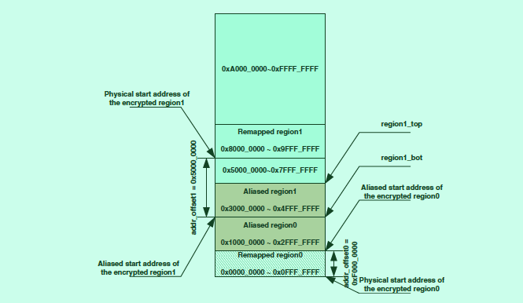
Address Remapping

Slide 25
Address Remapping
BEE is capable of remapping two individual regions (Region0 and Region1)
Two regions are biased with OFFSET0 and OFFSET1:
OFFSET0 = addr_offset0 – 0x1000_0000
OFFSET1 = addr_offset1 – 0x3000_0000
The two aliased spaces (aliased region 0 and aliased region 1) are fixed to [0x1000_0000~0x2FFF_FFFF] and [0x3000_0000~0x4FFF_FFFF]

Slide 26
Known hardware limitations
Only supports 128 bits data width AXI interconnection
Only supports 16-byte burst access size. For single transaction, the minimum supported access size is limited to 4-byte.
Granularity of the address bias is 128 KB per step
Maximum supported burst length is limited to 4.

Slide 27
DCP
Notes:
Data Co-Processor
supports symmetric AES-128 (ECB and CBC mode)
supports SHA-1/256
provides memory copy functionality
supports arbitration
processes data based on chained command structures written to the system memory by software (in a manner similar to the DMA engine).

Slide 28
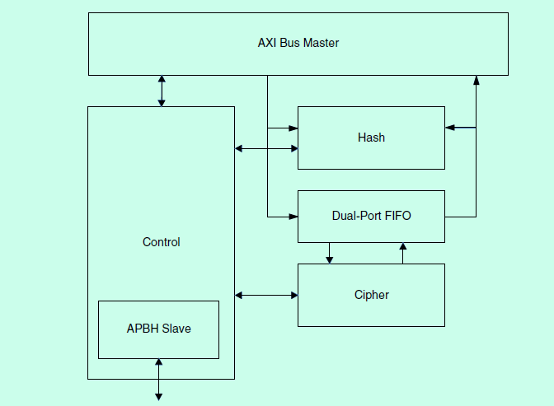
Block Diagram

Slide 29
Data Flow
Memcopy/blit mode-The data is moved unchanged from one memory buffer to
another.
Encryption only-The data from the source buffer is encrypted/decrypted into the destination buffer.
AXI
FIFO
AXI
AXI
FIFO
Encryption
Decryption
FIFO
AXI
Notes:
The Data Flow
can be configured in one of five fashions, depending on the functionality activated by the control packet

Slide 30
Encryption and input hashing-The data from the source buffer is encrypted/decrypted into the destination and the source buffer is hashed.
Encryption and output hashing-The data from the source buffer is encrypted/decrypted into the destination and the output data is hashed.
AXI
FIFO
Encryption
Decryption
FIFO
AXI
Hash
AXI
FIFO
Encryption
Decryption
FIFO
AXI
Hash

Slide 31
Cryptographic Engines
Hashing only-The data from the source buffer is read, and a hash is generated.
AXI
HASH

Slide 32
Operations
Memory copy functionality
incorporates the memory-copy (memcopy) function for debugging and as a more efficient method to copy data between memory blocks than the DMA-based approach. The memcopy buffers can be aligned to any memory address and can be of any length.
The memcopy function also has a "blit" mode of operation where it can transfer a rectangular block of data to a video frame buffer. Basic blit operations are typical in graphics operations. The blit source buffers must be contiguous. The output destination buffer for the blit operation is defined as a “M runs of N bytes” that defines a rectangular region in a frame buffer.
Provides a fill operation, where the source data does not come from another memory location, but from an internal register. This feature can be used with memcopy to prefill the memory with a specified value, or during a blit operation to fill a rectangular region with a constant color

Slide 33
Operation (cont’d)
Advanced Encryption Standard (AES)
Key storage
implements four SRAM-based keys that can be used by the software to securely store keys on a semi-permanent basis.
The keys may be written via the programming interface by specifying a key index and a subword pointer that indicates which word to write within the key.
The keys written into the key storage are not readable.
AES OTP key
After a system reset, the OTP controller reads the e-fuse devices and provides the OTP key information to the DCP.
The DCP receives a 64-bit UNIQUE KEY and a 128-bit CRYPTO KEY
Depending on the key path control fuse, the DCP receives the CRYTPO KEY either directly or indirectly through the SNVS trust controller module.
Encryption modes
Electronic Code Book (ECB) mode.
Cipher Block Chaining (CBC) mode
Notes:
To use a key in the key storage, the cipher descriptor packet must select the key by setting the DCP_Control1[KEY_SELECT] field in the Control1 descriptor field without setting the OTP_KEY or PAYLOAD_KEY fields in the Control0 register
To use the OTP key, the descriptor packet must set the OTP_KEY field in the Control1 register

Slide 34
Operation (cont’d)
Hashing
The SHA-1 block implements a 160-bit hashing algorithm that operates on 512-bit (64-byte) blocks, as defined by US FIPS PUB 180-1 in 1995
The SHA-256 mode implements a 256-bit hashing algorithm that operates on 512-bit (64-byte) blocks, as defined by US FIPS PUB 180-2 in 2002.
The CRC-32 algorithm implements a 32-bit CRC algorithm similar to the one used by Ethernet and many other protocols.
Notes:
The purpose of the hashing module is to generate a unique signature for a block of data that can be used to validate the integrity of the data by comparing the resulting "digest" with the original digest.
The CRC differs from the Unix cksum() function in these three ways:
The CRC is initialized as 0xFFFFFFFF instead of 0x00000000.
The logic pads the zeros to a 32-bit boundary for the trailing bytes.
The logic doesn't post-pend the file length.
The DCP also has the ability to check the resulting hash against a value in the payload and issue an interrupt if a mismatch occurs.

Slide 35
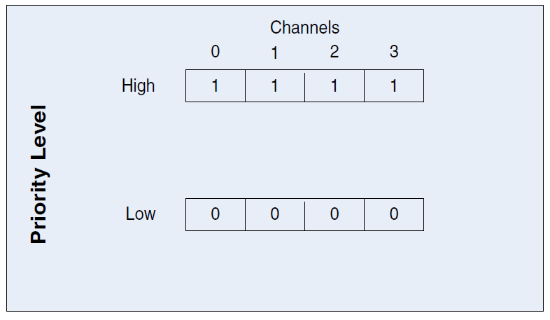
Operation (cont’d)
Arbitration and Performance
The DCP implements a multi-tiered arbitration policy that gives the software the flexibility in scheduling the DCP operations. This figure illustrates the arbitration levels and how each channel fits into the arbitration scheme:
Notes:
The DCP can have four channels and all competition for the DCP resources to complete their operations.
Depending on the situation, the critical operations may need to be prioritized above the less important operations to ensure a smooth system operation.

Slide 36
Limitation
The buffer sizes for all operations must be aligned to the natural size of the transfer algorithm used. If the byte count is not a word granularity, the hardware rounds up to the next word.
The memcopy operations can transfer any number of bytes (one-byte granularity)
the AES operations must be multiples of 16 bytes (four-words granularity)
The hashing is supported at one-byte granularity
The DCP module supports buffer operations to any byte alignment
the performance is improved if the buffers are aligned to a four-byte boundary
The hash operations are limited to a buffer size of 512 MB
For the chained hashing operations, every descriptor except the last must have a byte count that is a 16-word multiple

Slide 37
Limitation (cont’d)
The key values can't be written while the AES block is active.
The byte-swap controls can only be used with the modulo-4 length buffers
The word-swap controls are only useful for the cipher operations because the logic forms the 128-bit cipher data from four words from the system memory
The DCP only supports writes to the word boundaries to the OCRAM

Slide 38
TRNG
Notes:
Standalone True Random Number Generator
is a hardware accelerator module that generates a 512-bit entropy as needed by an entropy-consuming module or by other post-processing functions.
don’t include PRNG
The output of TRNG is intended for direct use by functions that generate secret keys, per-message secrets, random challenges, and other similar quantities used in cryptographic algorithms. In each of these cases, it is important that a random number be difficult to guess or predict.

Slide 39
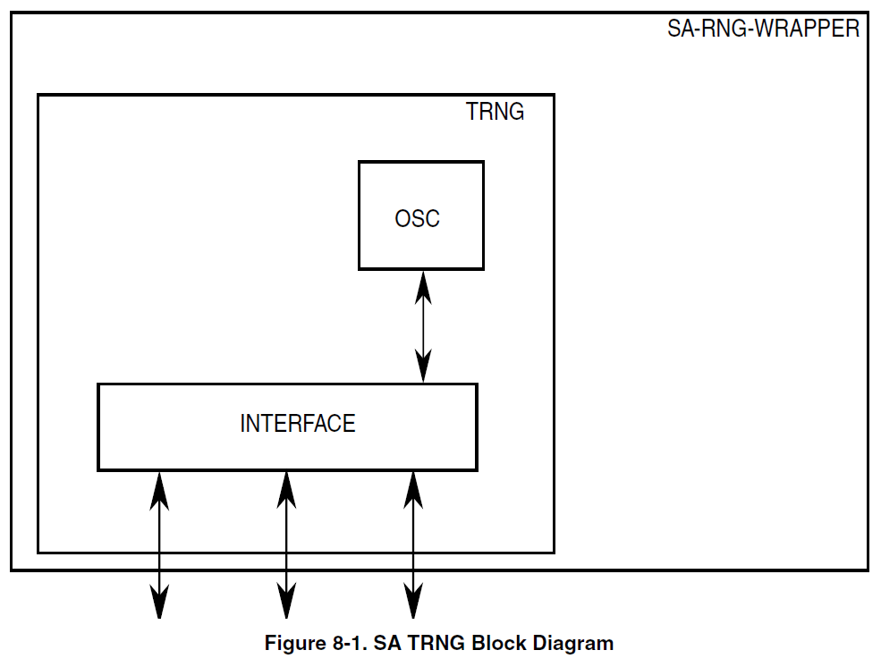
Block Diagram
Notes:
The TRNG contains the following sub modules: IP Slave bus (SkyBlue bus) interface, the TRNG Core and the free running oscillator (OSC).

Slide 40
Overall functionality
TRNG is based on collecting bits from a random noise source.
This random noise source is a ring oscillator that is sensitive to random noise (temperature variations, voltage variations, cross-talk and other random noise) within the device
This noise causes various small changes in the period of the oscillator.
The count of the ring oscillator clock cycles is sampled after a known period of time.
By using the variance in this count over a large number of samples, random bits can be derived.
TRNG comprises two entropy sources, each of which provides a single bit of output. Concatenated together, these 2 output bits are expected to provide 1 bit of entropy every 100 clock cycles.

Slide 41
Operations
Initialization.
Set up the parameters to proper values, and start generation of the first block of entropy.
Read entropy from the TRNG, and start generation of the next block of entropy.
Run a self-test on the TRNG, to assure proper continued operation.
Off-line determination and checking of TRNG parameter values.
Notes:
There are four things that a user (programmer/integrator) will want to do with a TRNG.

Slide 42
CSU
Notes:
Central Security Unit
manages the system security policy for peripheral access on the SoC.
allows trusted code to set individual security access privileges on each of the peripherals, using one of eight security access privilege levels.
may assign bus master security privileges during bus transactions according to programmed policy

Slide 43
Features
Peripheral access policy
the appropriate bus master privilege and identity are required to access each peripheral.
Masters privilege policy
the CSU overrides the bus master privilege signals (user/ supervisor, secure/non-secure) according to the access control policy.
Notes:
The CSU sets the access control policies between the bus masters and bus slaves, allowing for peripherals to be separated into distinct security domains. This protects against unauthorized access to data.

Slide 44
Policies
There are four security modes of operation (bus privileges) in the system distinguished by the security (TrustZone/non-TrustZone) and privilege (Supervisor/User) setting of the module.
TrustZone (secure) privilege (supervisor) mode—highest security level
TrustZone (secure) non-privilege (user) mode—medium security level
Non-TrustZone (regular) privilege (supervisor) mode—medium security level
Non-TrustZone (regular) non-privilege (user) mode—lowest security level
Notes:
According to its programmed policy, the CSU determines the bus master privileges and the masters that are allowed to access each of the slave peripherals.

Slide 45
Access table
CSU_SEC_LEEL[2:0] | Non-secure user mode | Non-secure SPVR mode | Secure (TZ) user mode | Secure (TZ) SPVR mode | CSL register value
(0) 000 | RD+WR | RD+WR | RD+WR | RD+WR | 8’b1111_1111
(1) 001 | NONE | RD+WR | RD+WR | RD+WR | 8’b1011_1011
(2) 010 | RD | RD | RD+WR | RD+WR | 8’b0011_1111
(3) 011 | NONE | RD | RD+WR | RD+WR | 8’b0011_1011
(4) 100 | NONE | NONE | RD+WR | RD+WR | 8’b0011_0011
(5) 101 | NONE | NONE | NONE | RD+WR | 8’b0010_0010
(6) 110 | NONE | NONE | RD | RD | 8’b0000_0011
(7) 111 | NONE | NONE | NONE | NONE | Any other value
Notes:
The Configure Slave Level (CSL) Register value for a specified peripheral resource defines the output signal (csu_sec_level) for that peripheral. The value of this signal determines the master privileges that can access the peripheral. The relationship between the value of the csu_sec_level signal and the security operation mode is shown in up table:

Slide 46
Mapping
Slave module | Corresponding CSL register and bit field

Slide 47
SNVS
Notes:
Secure Non-Volatile Storage
is a companion module to the DCP module and serves as the SoC’s central reporting point for security-relevant events such as the success or failure of boot software validation and the detection of security threat events. The security event information determines whether the SoC (hardware and software) is in the proper state to allow the DCP to use persistent and ephemeral secrets.

Slide 48
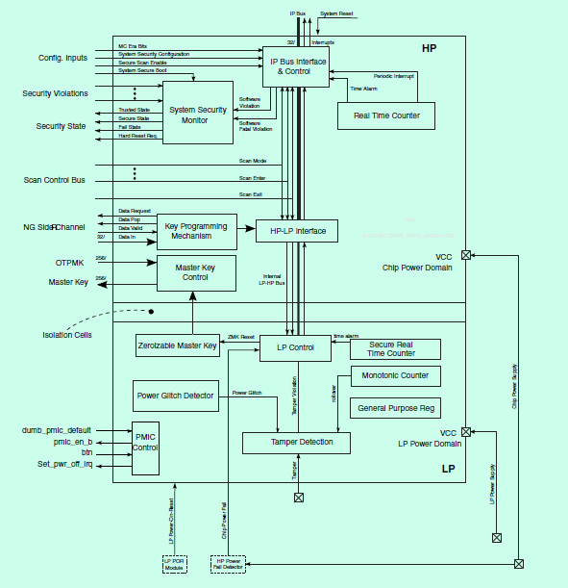
Block Diagram

Slide 49
Security Functions
Monitor security events in the SoC, and respond as per configured security policy
Protect certain security-critical data objects
Master Key - can be used by DCP when encrypting or decrypting blobs
Monotonic Counter (MC) - a monotonically increasing counter that can be used for replay detection
Secure Realtime Counter (SRTC) - realtime counter that can't be altered by untrusted software
Preserve state of the data objects listed above (if the SNVS_LP power input is connected to an uninterrupted power supply, e.g. a coin cell battery)
Notes:
In Master Key:
• One-Time Programmable Master Key (OTPMK) from fuses can be used as the source of the Master Key
• Zeroizable Master Key (ZMK) - can be used as the source of the Master Key
• OTPMK XOR ZMK (Combined Master Key, CMK) - can be used as the source of the Master Key

Slide 50
Non-security functions
Realtime Counter (RTC) - a software accessible realtime counter
Periodic Interrupt - a hardware-generated interrupt that occurs periodically at software-specified frequency
General Purpose Register - a set of registers used to hold 128 bits of data specified by software
Chip power-on/power-off
Notes:
3:If the SNVS_LP power input is connected to an uninterrupted power supply, e.g. a coin cell battery, the GPR value is maintained when main SoC is powered off
4: If the SNVS_LP power input is connected to an uninterrupted power supply and the Power On button input signal is connected to a power button external to the chip, logic within SNVS_LP can be used to wake the chip from a power down.

Slide 51







Inside blocks
Security Violations
i.MX
Security State
OCOTP
OTP Master
Key
CAAM
SJC
WDOG
SNVS
System Security Monitor
47 bit counter
CAAM Master Key
HP
Master Key
Control
Sync
32 bit GP Register
48 bit Monotonic Counter
47 bit counter
Zeroizable Master
Key
Security Violation
32.768kHz
Tamper Detectors
Monotonic Counter
Rollover
Protection Mechanism
Power Supply
Glitch
Detectors
LP
Analog
Sensors
Tamper Inputs
external to SNVS

Slide 52
Structure
The SNVS block is divided into two major submodules based on power supply, the high power domain (SNVS_HP) and the low power domain (SNVS_LP):
SNVS_HP - system (chip) power domain
SNVS_LP - dedicated always-powered-on domain
Notes:
The SNVS_HP section contains all SNVS status and configuration registers. It implements all features that enable system communication and provisioning of the SNVS_LP section. The SNVS_HP section also incorporates the security state machine, which controls the system security state, and the master key control block, which is responsible for checking and selecting the master key value.
The SNVS_LP section provides hardware that enables secure storage and protection of sensitive data. The SNVS module is designed to safely hold security-related data such as cryptographic key, time counter, monotonic counter, and general purpose security information.

Slide 53
Power domain
SNVS_HP – System Power Domain
IP bus interface
SNVS_LP interface
System security monitor
Master key control block
Zeroizable master key programming mechanism
Real time counter with alarm
Control and status registers
SNVS_LP – Dedicated Power Domain
Zeroizable master key
Secure real time counter
General purpose register
Control and status registers
Monotonic Counter
Notes:
System security monitor:
SNVS implements a security state machine (SSM) that tracks the security state of the SoC. The states and state transitions of the SSM affect certain security actions taken by SNVS.

Slide 54
Features
Security State Machine (SSM)
Receives configuration inputs from SoC fuses
Receives security violation inputs from the various detectors in the chip
Tracks security state
Generates security state outputs to DCP and other logic within the chip
Can request system hard reset in case of non-recoverable violation
Programmable high assurance counter (HAC) to control time delay before system hard reset request generation

Slide 55
Features
Security State Machine (SSM)
Master key checking and control
Performs validity checks for the one-time programmable master key before allowing DCP to use it
Performs validity checks for the zeroizable master key before allowing DCP to use it
Selects the device-specific master key value as the OTPMK, the ZMK, or the bit-wise exclusive OR of both the OTPMK and the ZMK

Slide 56
Features
Security State Machine (SSM)
Master key checking and control
Zeroizable master key (ZMK)
The ZMK value can be programmed via software or via a hardware interface to DCP's random number generator
The ZMK value can be selected for use in encapsulating or decapsulating DCP blobs
The ZMK value is zeroized when a security violation occurs
If the SNVS_LP power input is connected to an uninterrupted power supply (see SNVS power domains), the value is maintained even when the main SoC is powered off.

Slide 57
Features
Security State Machine (SSM)
Master key checking and control
Zeroizable master key (ZMK)
Secure real time counter (SRTC)
The SRTC is driven by a dedicated clock that is functionally independent of the chip configuration.
The SRTC does not rollover. Instead the SRTC logic issues an alarm if the SRTC reaches its maximum value.
Programmable time alarm interrupt
Software can program the SRTC to generate an interrupt at a specific time.
If the main SoC is powered down at the programmed alarm time and the wake-up external alarm is enabled, the SRTC generates a wake-up alarm via an external pin. (Assuming that the SNVS_LP power input is connected to an uninterrupted power supply, see SNVS power domains)
• The SRTC value is marked as invalid if an SNVS tamper event is detected.

Slide 58
Features
Security State Machine (SSM)
Master key checking and control
Zeroizable master key (ZMK).
Secure real time counter (SRTC)
Real time counter (RTC)
• The RTC is driven by a dedicated clock, which is off when the
system power is down.
The RTC can be synchronized to the value of the Secure Real Time Counter.
Programmable time alarm interrupt
Periodic interrupt can be generated with software-selected frequency.

Slide 59
Features
Security State Machine (SSM)
Master key checking and control
Zeroizable master key (ZMK).
Secure real time counter (SRTC)
Real time counter (RTC)
Monotonic counter
The monotonic counter can only increment.
The monotonic counter does not rollover. Instead the monotonic counter logic issues an alarm if the monotonic counter reaches its maximum value.
The monotonic counter value is marked as invalid if an SNVS tamper event is detected.
If the SNVS_LP power input is connected to an uninterrupted power supply (see SNVS power domains), the monotonic counter value is retained even if the main chip is powered down.

Slide 60
Features
Security State Machine (SSM)
Master key checking and control
Zeroizable master key (ZMK)
Secure real time counter (SRTC)
Real time counter (RTC)
Monotonic counter
General-purpose register
The general-purpose register is available to software to store 128 bits of data.
The general-purpose register is zeroized when a security violation is detected.
If the SNVS_LP power input is connected to an uninterrupted power supply (seeSNVS power domains), the general-purpose register value is retained even if the main chip is powered down.

Slide 61
Features
Security State Machine (SSM)
Master key checking and control
Zeroizable master key (ZMK).
Secure real time counter (SRTC)
Real time counter (RTC)
Monotonic counter
General-purpose register
Register access restrictions
Registers can be programmed only when the SNVS is in functional state, i.e. not in scan mode.
Some registers/values can be written only once per boot cycle.

Slide 62
Features
Security State Machine (SSM)
Master key checking and control
Zeroizable master key (ZMK)
Secure real time counter (SRTC)
Real time counter (RTC)
Monotonic counter
General-purpose register
Register access restrictions
Violation/tamper detection and reporting
Detects the following security violations
Direct connections to DCP to lock out access to the OTPMK/ZMK and force zeroization of sensitive information
Configurable triggers a device hard reset
Configurable reports to software (interrupts) all security violation and functional events
Notes:
Detects on internal to the block:
Scan exit
Power glitch
Invalid OTPMK (ECC check failure)
ZMK ECC check failure
SRTC rollover
MC rollover
Detects on external to the block:
Software-reported violations
5 security violation inputs

Slide 63
Features
Security State Machine (SSM)
Master key checking and control
Zeroizable master key (ZMK)
Secure real time counter (SRTC)
Real time counter (RTC)
Monotonic counter
General-purpose register
Register access restrictions
Violation/tamper detection and reporting
Wakeup from power off
Input signal from off chip requests SNVS_LP to power on the main SoC (Assuming that the SNVS_LP power input is connected to an uninterrupted power supply (see SNVS power domains).
Hardware denounces the input signal using software-specified signal bounce characteristics

Slide 64
Violation policy
The nature of the response to various types of security relevant events can be set by configuring the SNVS security policy appropriately
"Security Violation" inputs when SoC power is on:
OTPMK Hamming code error – internal source
ZMK Hamming code error – internal source
Security Violation 0/1/2/3/4/5 – external source
Software Violation – SNVS_HP Command register (HPCOMR).
"Security Violation" inputs when SoC power is off:
Power Glitch Violation – external source
SRTC Rollover Violation – internal source
MC Rollover Violation – internal source
Notes:
The SoC firmware specifies SNVS's response to security violations by configuring the SNVS_HP security policy. At boot time the SoC boot firmware also checks the status of the SNVS_LP section. If the LP section has not been securely initialized, or has been tampered, or the coin cell battery has been replaced, the status check will indicate that the state of the LP section is invalid, and the boot firmware will configure the SNVS_LP security policy.

Slide 65
Master Key checking and control
when DCP is in the Trusted or Secure mode the key value used is the Master Key supplied by the SNVS
the Master Key supplied to DCP comes from one of the following sources:
One Time Programmable Master Key (OTPMK)
Zeroizable Master Key (ZMK)
Combined Master Key (CMK)
the Master Key is used by the DCP only as a key derivation key, and only during blob operations
Notes:
OTPMK:
is permanently burned into fuses. The 256-bit value includes an embedded 9-bit Hamming code so that hardware can verify the integrity of the key. If the OTPMK Hamming code check fails or the OTPMK is not programmed at all (all 0s), the hardware will report a "bad key" error which will prevent the chip from reaching the Trusted/Secure state.
ZMK:
is stored in the ZMK registers of the low power (LP) section of the SNVS. The value is automatically erased in response to fatal security
violations.
CMK:
is the bitwise XOR of the OTPMK registers and the ZMK registers.

Slide 66
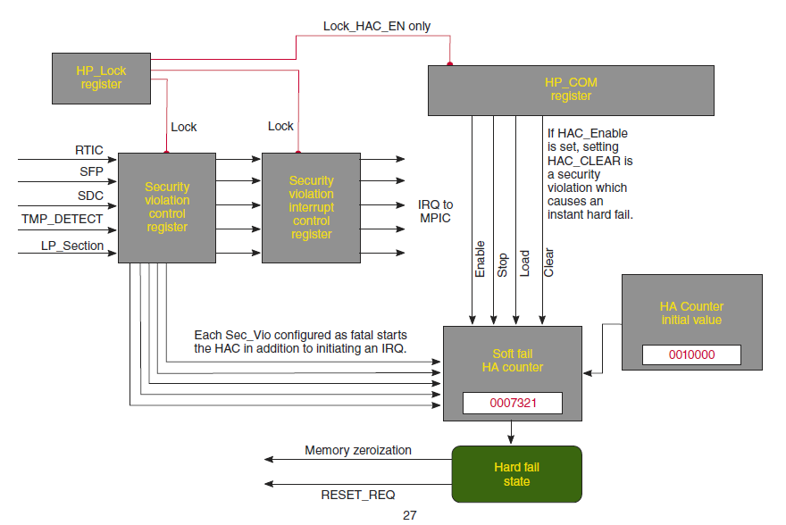
Reset and Initialization

Slide 67
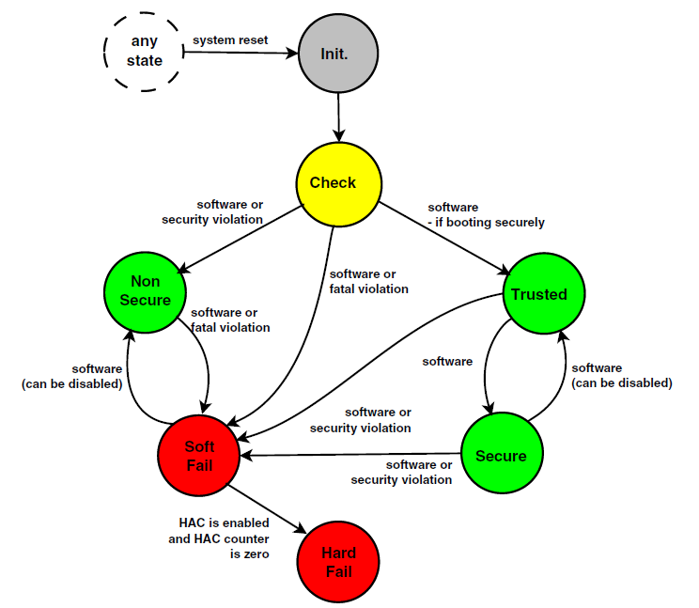
Security State Machine
Notes:
SSM
tracks the security state of the SoC. The states and state transitions of the SSM affect certain security actions taken by
SNVS and DCP.

Slide 68
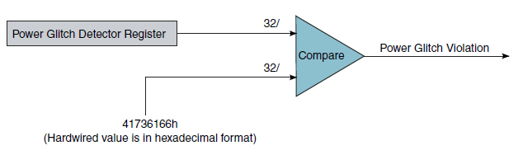
Power glitch detector
The mechanism works as follows:
The PGD register (LPPGDR) is loaded to the known specific value 4173_6166h as part of the SNVS initialization process.
This register's value is compared to a hardwired value to detect a glitch in the LP power supply.
Notes:
PGD:
is mechanism to detect an attack in which someone power gates the SNVS_LP power supply for short periods to cause the LP control, status, and secure counter values to change. This mechanism detects and alerts the system whenever power supply glitches endanger SNVS_LP register values.
is always enabled and cannot be disabled.

Slide 69
OCOTP
Notes:
On-Chip One-Time Programmable Element Controller
This section contains information describing the requirements for the on-chip eFuse OTP controller along with details about the block functionality and implementation. The words "eFuse" and "OTP" are interchangeable.

Slide 70
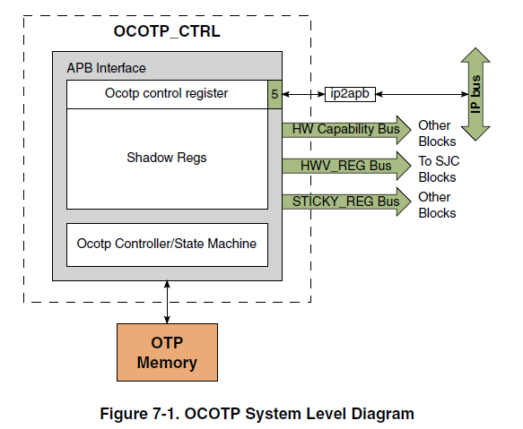
Block diagram

Slide 71
Features
32-bit word restricted program and read to of eFuse OTP
Loading and housing of fuse content into shadow registers
Memory-mapped(restricted) access to shadow registers
Generation of HWV_FUSE and HWV_REG bus which is made of up volatile PIO register based “fuses”. The HWV_REG bits come from the SCS register
Generation of STICKY_REG which consists of sticky register bits
Provides program-protect and read-protect eFuse
Provides override and read protection of shadow registers
CRC32 test for read-lock fuse content
Notes:
HWV_FUSE bus (hardware visible fuse bus)
emanates from the OCOTP block and goes to various other blocks inside the chip.
is made of the shadow register bits. The fuse bits are initially copied from the banks after rest is deasserted. When all fuse bits are loaded into their shadow registers, the OCOTP asserts the fuse_latched output signal.
SCS (Software Controllable Signals)
SCS bits are intended to be used as volatile fuse bits under software control.

Slide 72
Operation
Shadow register reload
Fuse and Shadow register read
Fuse and Shadow register write
Write postamble
Notes:
By IP bus interface of the OCOTP, can do operations as below:
Configure control registers for programming and reading fuse wordbank
Override and read shadow registers

Slide 73
eFuSE
Notes:
The words "eFuse" and "OTP" are interchangeable.
The OCOTP is always active. The shadow registers automatically load the appropriate OTP contents after reset is deasserted.

Slide 74
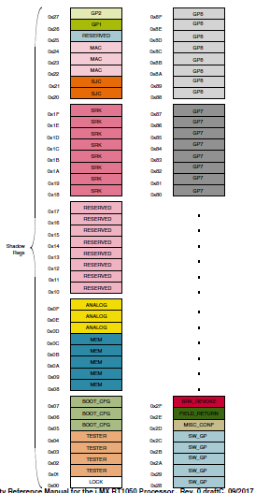
OTP Memory Footprint
Notes:
The registers are grouped by lock region. Their names are correspond to PIO register and fusemap names.

Slide 75
eFuse for Boot ROM
BT_FUSE_SEL
If BOOT_MODE[1:0] = 0b10:
0—The bits of the SBMR are overridden by the GPIO pins.
1—The specific bits of the SBMR are controlled by the eFUSE settings.
If BOOT_MODE[1:0] = 0b00
0—The BOOT configuration eFuses are not programmed yet. The boot flow jumps to the serial downloader.
1—The BOOT configuration eFuses are programmed. The regular boot flow is performed.
SEC_CONFIG[1:0]
01—Open (allows any program image, even if the authentication fails)
1x—Closed (The program image executes only if authenticated)
FIELD_RETURN
0—The NXP reserved modes are enabled/disabled based on the DIR_BT_DIS value.
1—The NXP reserved modes are enabled.
SRK_HASH[255:0]
Settings vary—used by HAB

Slide 76
eFuse for serial NOR/FlexSPI
BOOT_CFG1[1]
1 - enable Encrypted XIP
BOOT_CFG1[3:2]
Hold time before read from device
BOOT_CFG1[7:4]
Boot device selection
BOOT_CFG2[2:0]
Flash Type
BOOT_CFG2[3]
Infinite-Loop (Debug use only)

Slide 77
eFuse for serial NAND
BOOT_CFG1[1:0]
BOOT_CFG1[3:2]
BOOT_CFG1[4]
BOOT_CFG1[5]

Slide 78
SJC
Notes:
System JTAG Controller
provides debug and test control with the maximum security.
Test Access Port (TAP)
is designed to support features compatible with the IEEE Standard 1149.1 v2001 (JTAG).

Slide 79
Features
JTAG IEEE1149.1 mandatory instructions, see EXTEST Instruction, SAMPLE/ PRELOAD Instruction , and BYPASS Instruction .
JTAG IEEE1149.1 optional instructions, see ID_CODE Instruction (IDCODE) , and HIGHZ Instruction.
JTAG IEEE P1149.1 (standard JTAG) interface to off-chip test and development equipment including an SJC-only mode for true IEEE 1149.1 compliance, used primarily for board-level implementation of boundary scan.
IEEE P1149.6 (JTAG) mandatory instructions, see EXTEST_PULSE instruction and EXTEST_TRAIN instruction. These two instructions enable edge-detecting behavior on the signal path containing AC pins.
Debug-related control and status, such as putting selected cores into reset and/or debug mode and the ability to monitor individual core status signals via JTAG.
ExtraDebug logic (see ENABLE_ExtraDebug Instruction ).
Core compliant modes to support standalone core debuggers (see Modes of Operation).

Slide 80
Security Mode
Mode #1: No Debug-Maximum Security. All security sensitive JTAG features are permanently blocked.
Mode #2: Secure JTAG-High security. JTAG use is regulated by secret key based authentication mechanism.
Mode #3: JTAG Enabled-Low security. JTAG always enabled.
Notes:
The JTAG security modes are configured using eFUSEs which can burned after packaging by applying electrical signals. The fuse burning is irreversible process, once a fuse is burned (e-fuse or laser fuse) it is impossible to change the fuse back to the unburned state.

Slide 81
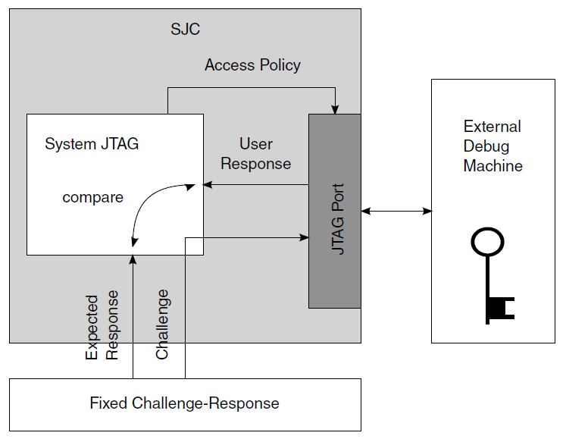
Mode #2 - Secure JTAG with Fixed Challenge-response Pair

Slide 82
Software Enabled
To increase the flexibility of the SJC, an option to enable the JTAG via software is added and is available only in Secure JTAG mode.
By writing '1' to HAB_JDE (HAB JTAG DEBUG ENABLE) bit in the e-fuse controller module, the JTAG is opened, regardless of its security mode. It is the responsibility of software to assert or negate this bit.
The S/W JTAG enable allows JTAG enabling without activating the challenge-Response mechanism (which requires JTAG access tool enhancement or special H/W)
The JTAG S/W enable does not allow debug in case of boot or memory fault as it requires reset before entering debug
The JTAG S/W enable can be permanently blocked by burning the dedicated e-fuse
Notes:
The S/W enabled JTAG feature reduces the overall security level of the system as it relies on S/W protections. If this feature is not required, it is strongly recommended to burn the JTAG_HEO e-fuse which disables this feature.

Slide 83
Kill Trace
The kill trace signal disables any output of the ETM block
The intention of this action is to block any attempt to break into the system via software manipulation of the debug modules
When the kill trace is active, prevents trace output even in case where it can be activated via chip pin.
The kill trace needs to be activated by burning a dedicated e-fuse
Notes:
The kill trace is asserted when "kill trace enable" fuse is burned and "ipt_secur_block“ signal in SJC is asserted, which happens when at least one of the following is true:
Mode #2 (Secure JTAG) and no code has been entered
Mode #2 (Secure JTAG) with burned Bypass and Re-enable fuses
Mode #2 (Secure JTAG) with incorrect response entered
Mode #1 (No debug)
TRST_B signal is active
POR has not ever been asserted

Slide 84
Disable Fuse
JTAG Disabled with highest level of JTAG protection
In this mode all JTAG features are disabled
Specifically, the following debug features are disabled:
Memory BIST
Boundary scan register (SJC_BSR)
Non-Secure JTAG control registers (PLL configuration, Deterministic Reset, PLL bypass)
Non-Secure JTAG status registers (Core status)
Chip Identification Code (IDCODE)
Notes:
There is an option to disable the SJC functionality by eFUSE configuration.

